Slide 1
Stage 2 Midpoint Checkin
Aditya Dhawan, Pedro Guardado Rodezno, Medha Karthik, Chris Pitre, Denzel Fowler

Slide 2
Academic Papers

Slide 3
DeepFood: Deep Learning-Based Food Image Recognition for Computer-Aided Dietary Assessment- Chang Liu, Yu Cao
What was it?
The paper aimed to solve the issue of deriving food information, such as food type and portion size, from food images through a new CNN algorithm.
Relevance
Used 2 datasets: UEC, developed by the DeepFoodCam project, which contained 256 categories with around 28000 total images
Researchers achieved a 77.4 % accuracy rate compared to 56.4% and 50.76% accuracy reached through previous research.
Able to reach these levels of accuracy through the use of a bounding box to crop the raw image
Results
Using a bounding box to crop the images to show only the food itself as a strategy to increase accuracy could be applied to our project
Notes:
Liu, C., Cao, Y., Luo, Y., Chen, G., Vokkarane, V., Ma, Y. DeepFood: Deep Learning-Based Food Image Recognition for Computer-Aided Dietary Assessment. In: Chang, C., Chiari, L., Cao, Y., Jin, H., Mokhtari, M., Aloulou, H. (eds) Inclusive Smart Cities and Digital Health. ICOST 2016. Lecture Notes in Computer Science(), vol 9677. Springer, Cham. https://doi.org/10.1007/978-3-319-39601-9_4

Slide 4
Application of Deep Learning in Food: A Review
What was it?
This is a review of multiple different academic articles concerning deep learning and food science.
Relevance
A number of the articles reviewed were about food classification, and the quality detection of vegetables and fruits, and the quality detection of meat. This information can be used to help develop our project.
Results
There are a multitude of different uses of deep learning algorithms for food classification.
Notes:
Zhou, Lei, et al. “Application of deep learning in Food: A Review.” Comprehensive Reviews in Food Science and Food Safety, vol. 18, no. 6, 2019, pp. 1793–1811, https://doi.org/10.1111/1541-4337.12492.
(Chris)

Slide 5
YOLOv5 and Pests: Good Practice for our Network?
Ahmad, Iftikhar, et al. “Deep Learning Based Detector YOLOv5 for Identifying Insect Pests.”
What was it?
Study to detect different insect pests in susceptible crops
Relevance
Encourages strong use of Deep Learning approach
Analysis of YOLOv5 network
Their results
Many different iterations of YOLO used
YOLOv5 deep learning detector produced best detection results
Despite noise and varying conditions of data
Notes:
Ahmad, Iftikhar, et al. “Deep Learning Based Detector YOLOv5 for Identifying Insect Pests.” Applied Sciences, vol. 12, no. 19, Oct. 2022, p. 10167. Crossref, https://doi.org/10.3390/app121910167. https://www.mdpi.com/2076-3417/12/19/10167
(Aditya)

Slide 6
Machine Learning Based Approach on Food Recognition and Nutrition Estimation
Zhidong Shen , Adnan Shehzad , Si Chen , Hui Sun , Jin Liu
What was it?
A document describing the methods used in deep learning to recognize food category types and their nutritional values.
Relevance
The experiment used 3 different CNN models with 50,000 images
Accuracy achieved through these models ranged between 78.3% to 98.31%
The document describes setbacks to the systeming, and areas to improve on for future experiments
Results
For composite foods, such as salad, we need image segmentation for get the distinct features.
Many models will work for this type of system, but Inception-v3 and Inception-v4 seem to perform best.

Slide 7
Deep Learning Detection of Cancer Metastases on the Brain on MRI
Min Zhang PhD, Et al.
What is it?
A study on the use of computer vision technology and deep-learning to find brain metastasis on MRIs.
Relevance
The contributors go into detail the process from data collection with accredited doctors to the breakdown of their training and testing.
The article also exposes the reader to challenges that were encountered, like the small size of metastasis and how they frequently change. Something similar is expected to our problem statement
Results
12/276 metastases were missed by the completed model giving it an approximate 95% accuracy. In the end this deep-learning technology may become crucial as it is studied and developed.
Notes:
Zhang, M., Young, G. S., Chen, H., Li, J., Qin, L., McFaline-Figueroa, J. R., Reardon, D. A., Cao, X., Wu, X., & Xu, X. (2020). Deep-Learning Detection of Cancer Metastases to the Brain on MRI. Journal of Magnetic Resonance Imaging, 52(4), 1227-1236. https://doi.org/10.1002/jmri.27129

Slide 8
Open Source
Open source code available
Food 101- contains images of 101 different types of food, organized by type of food
UEC Food 256- contains 256 different types of food, each image has a bounding box around the food item
Communities
The communities surrounding food detection remain very active, as seen by the amount of new research being done
Labeled data
Although beyond the scope, could make use of open-source data to observe functionality and performance of model
Notes:
Food-101: https://www.kaggle.com/datasets/dansbecker/food-101/data
UEC Food 256: http://foodcam.mobi/dataset256.html

Slide 9
Next Steps and Challenges
Next Steps
Use the academic sources listed previously as a framework
Complete labeling of data
Create a model for food classification
Conduct experiments
Challenges
Increasing accuracy of model
Increasing amount of data

Slide 10
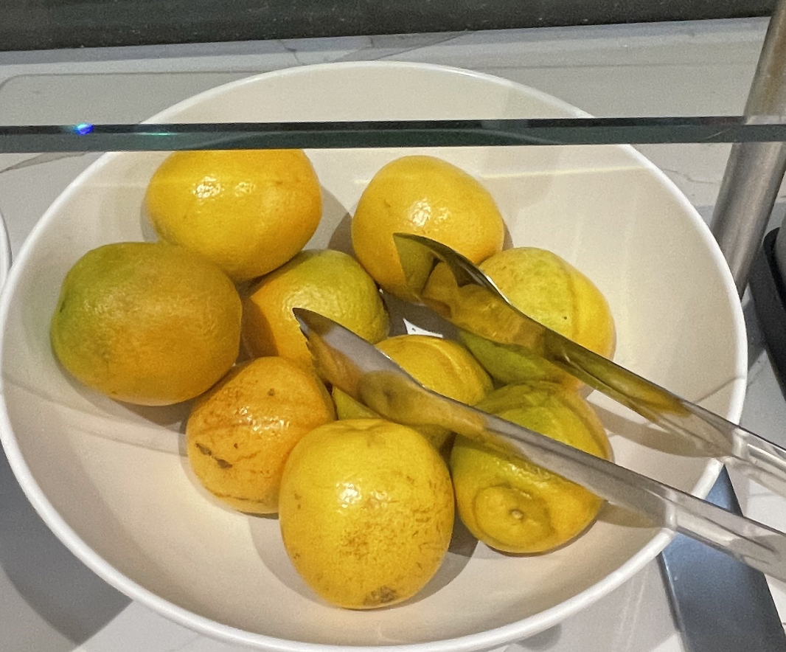
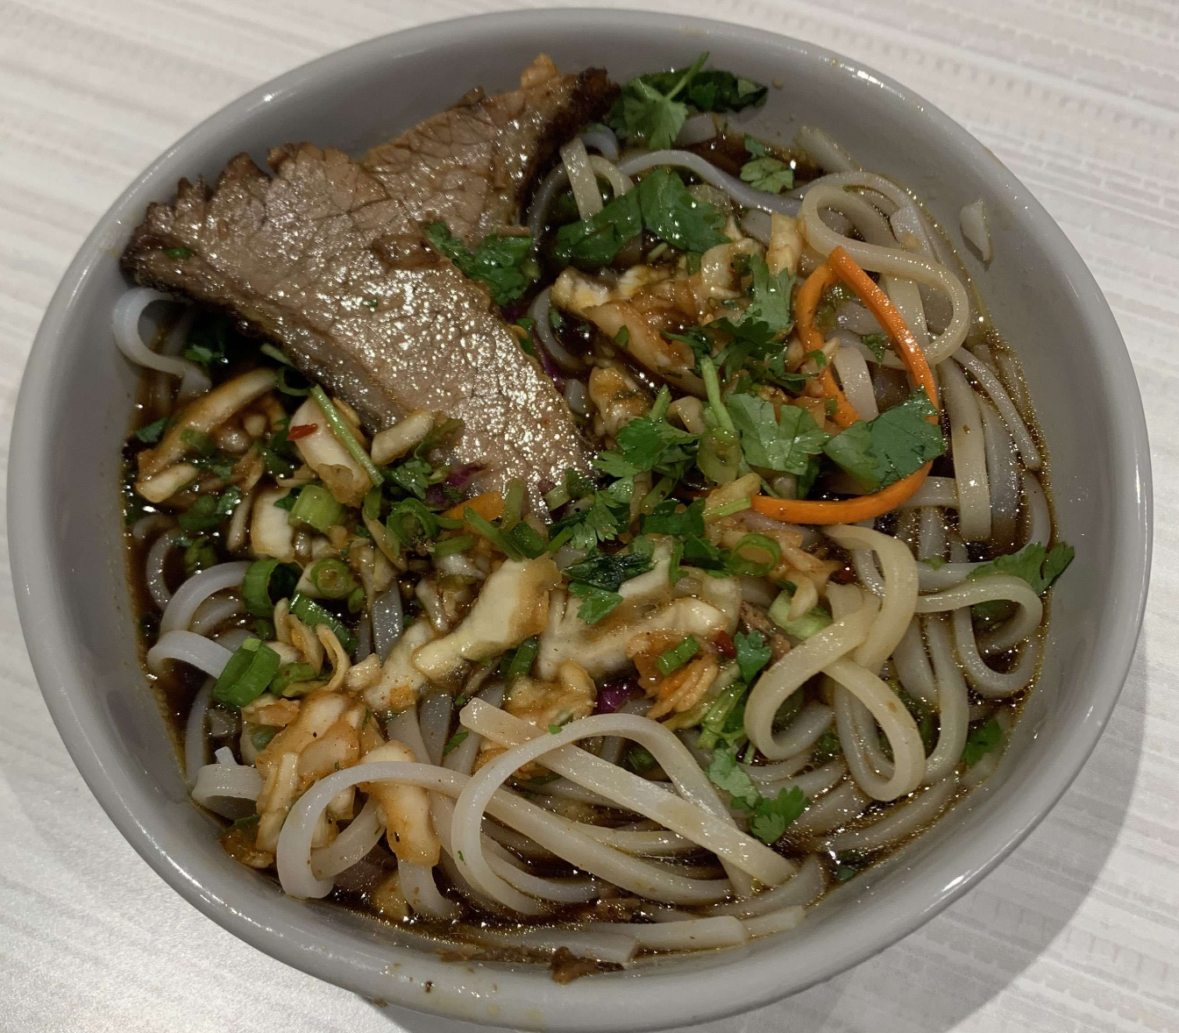
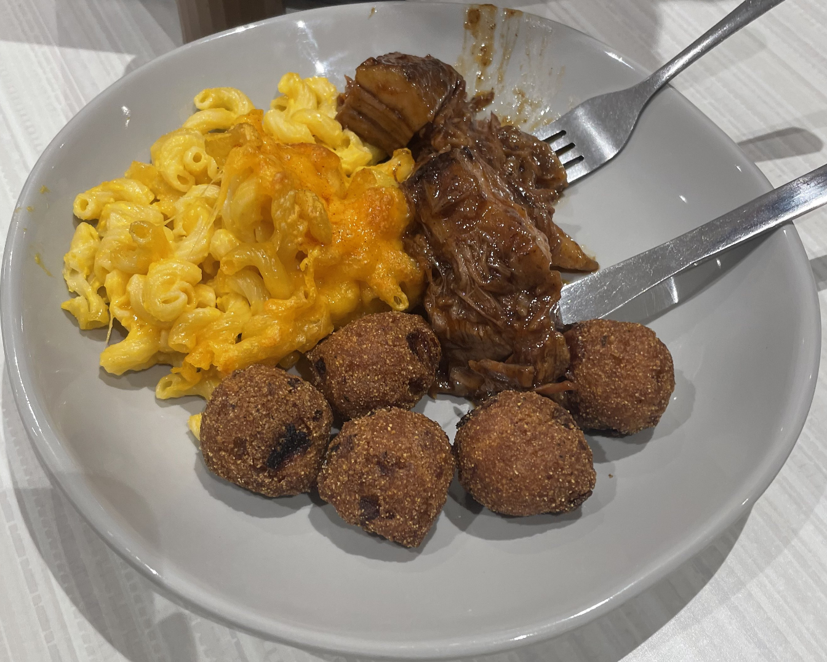
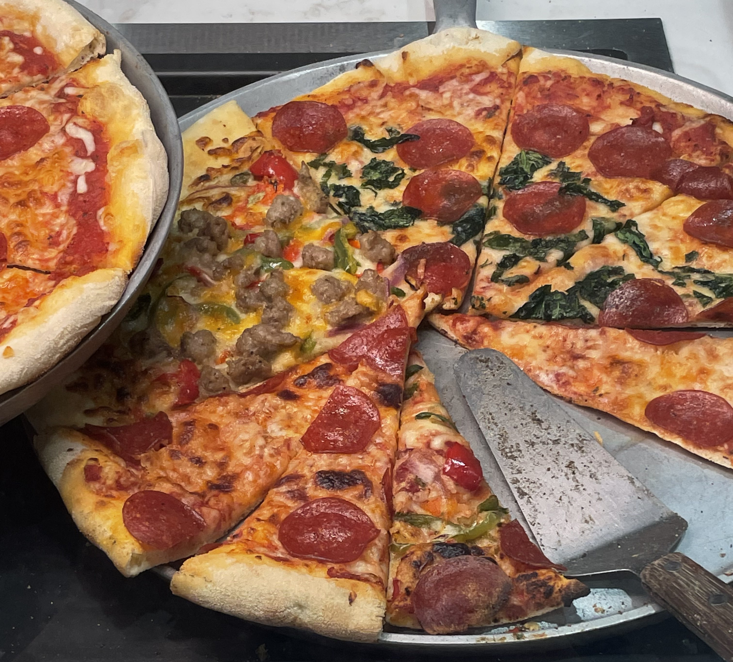
Data
The data we have collected so far are images from Social 704 of varying foods ranging from fruits and vegetables in serving dishes, and plates, to full meals on plates.
The plan is to take enough photos to represent the range of foods Social 704 offers, and to augment and jitter the images to allow for even more samples to train the deep learning algorithm with.
Example images are on the right

Slide 11
Notebook
https://colab.research.google.com/drive/10dfTIebba2m913dcIWFXkagbbjyH_EXO?usp=sharing

